Slide 1
AIML Premalatha T

Slide 2

WHO AM I?
LinkedIn: https://www.linkedin.com/in/latha-t-k-b21018128/
Data Science ,AIML
Data Analysis ,SQL,Pyspark
Data Visualization ,PowerBI,Tableau
Natural Language Processing (NLP)
Computer Vision
Generative AI,Prompt Engineering
BigData and Data Engineering

Slide 3
Agenda
What is ML,DL and AI
Steps in a ML Project
ML Techniques and Tools
DS Learning Path

Slide 4
Data?
Information and Noise(Insignificant information)
ML ,DS,AI-> Extract information(Exclude noise)

Slide 5
Types of Analytics
In today's data-driven world, information is king. But raw data itself isn't enough.
We need to analyze it to extract insights and make informed decisions

Slide 6
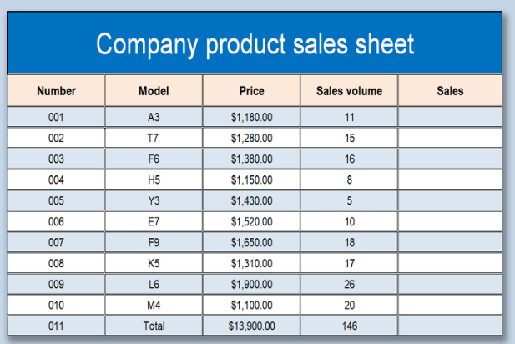
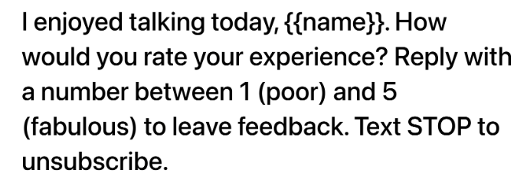

Slide 7
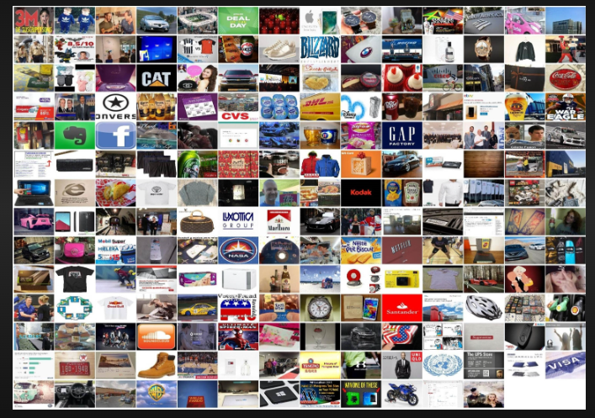
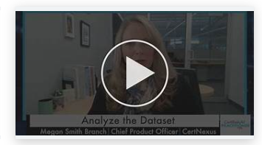
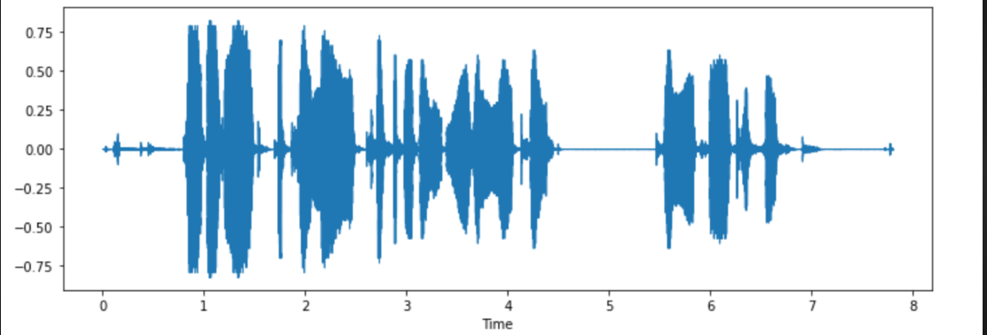

Slide 8






Slide 9
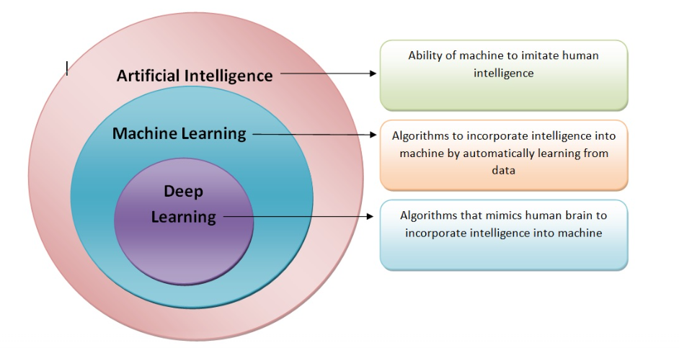

Slide 10
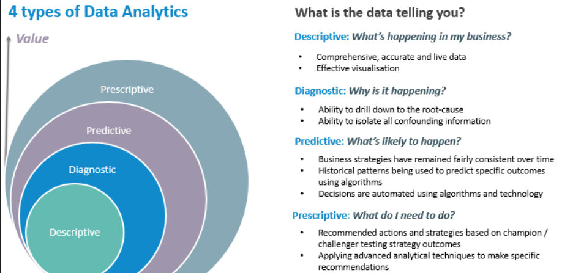

Slide 11
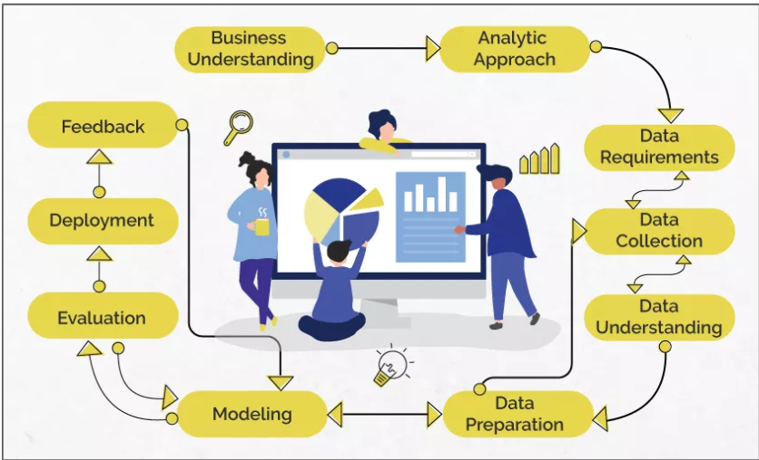
Data Science/Machine Learning

Slide 12
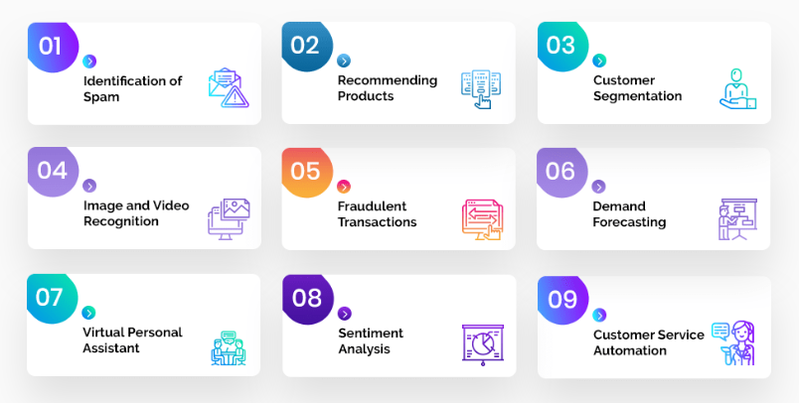
Problem Statement

Slide 13
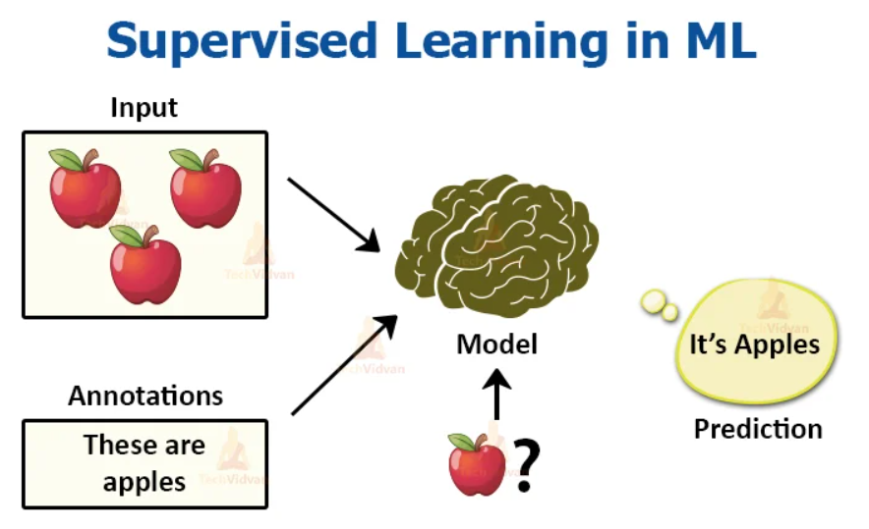
Analytic Approach

Slide 14
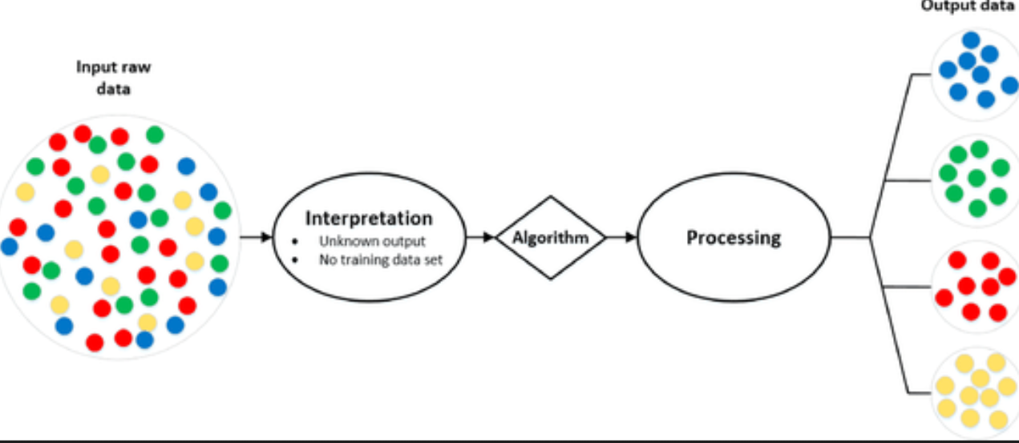
Analytic Approach

Slide 15
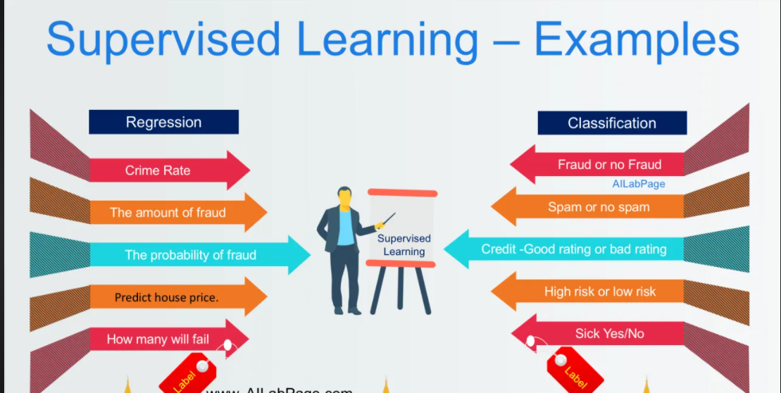
Supervised Learning

Slide 16
Machine Learning
Supervised Learning
Unsupervised Learning

Slide 17
Questions ????

Slide 18
STATISTICS
INTRODUCTION TO STATISTICS

Slide 19
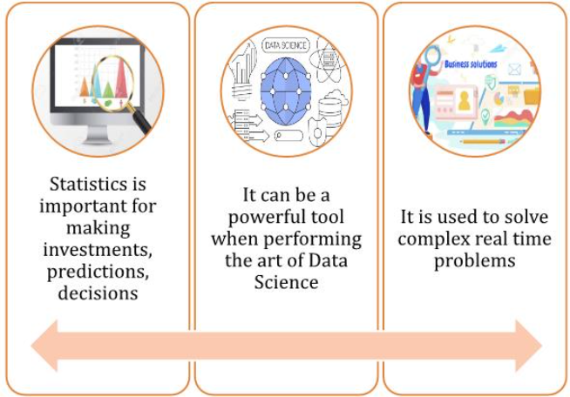

Slide 20
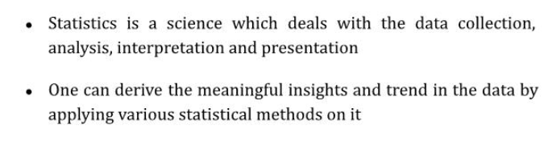

Slide 21
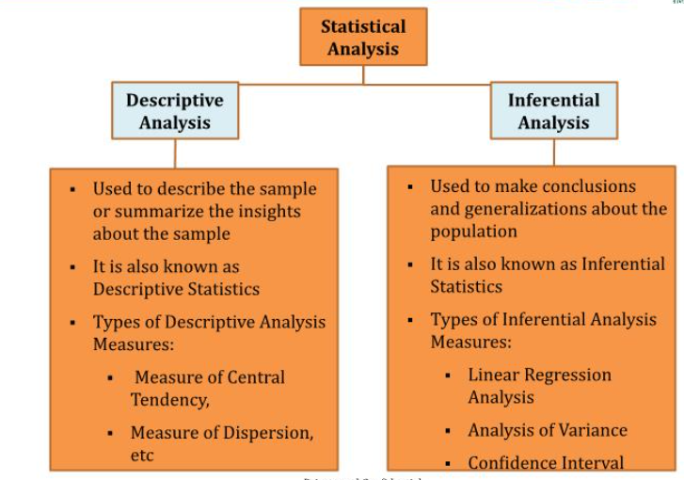

Slide 22
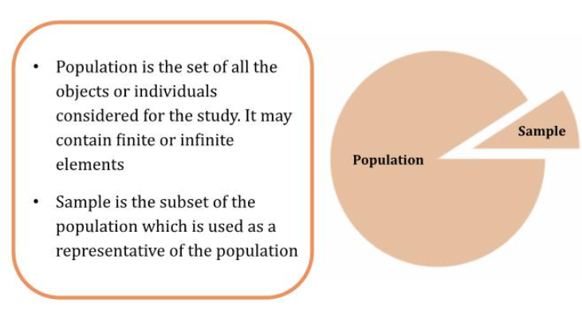
Population and Sample

Slide 23
Descriptive Statistics

Slide 24
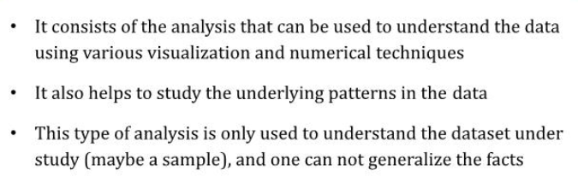

Slide 25
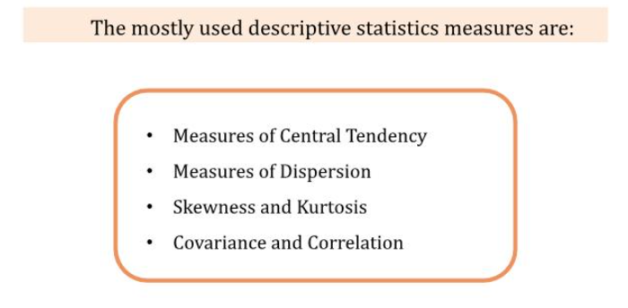

Slide 26
Measures of Central Tendency

Slide 27
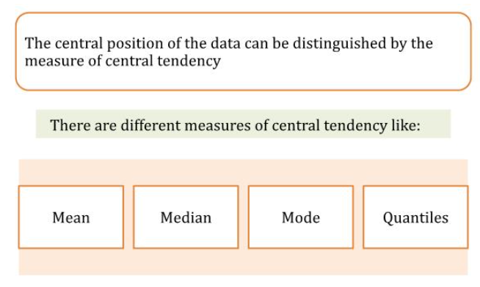

Slide 28
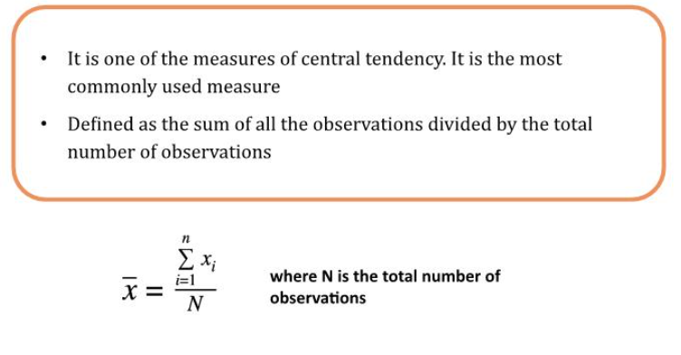
Mean

Slide 29
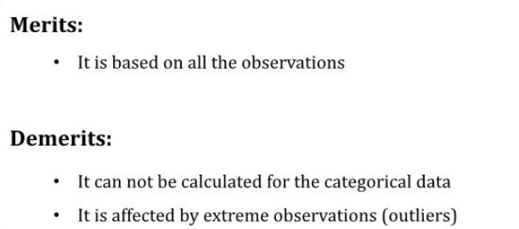

Slide 30
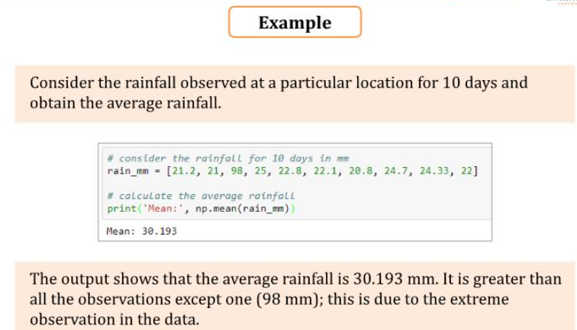

Slide 31
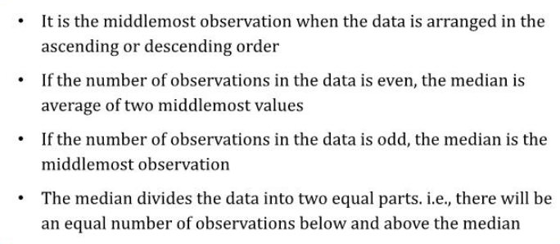
Median

Slide 32
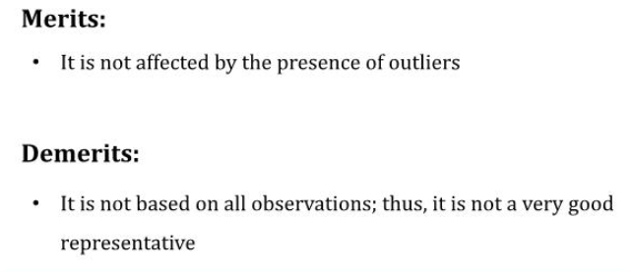

Slide 33
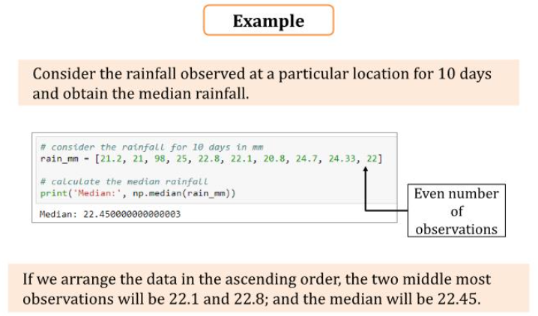

Slide 34
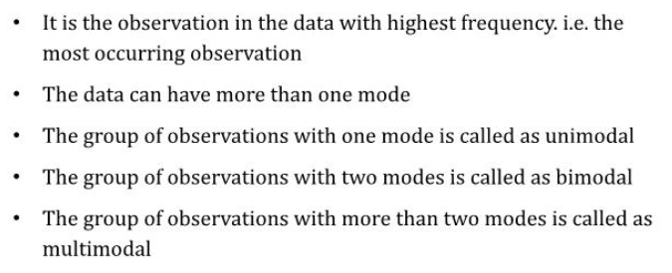
Mode

Slide 35
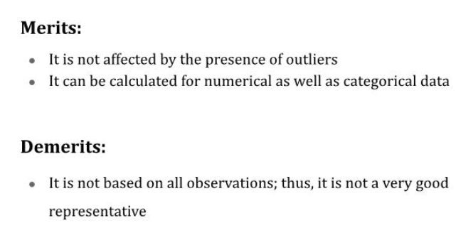

Slide 36
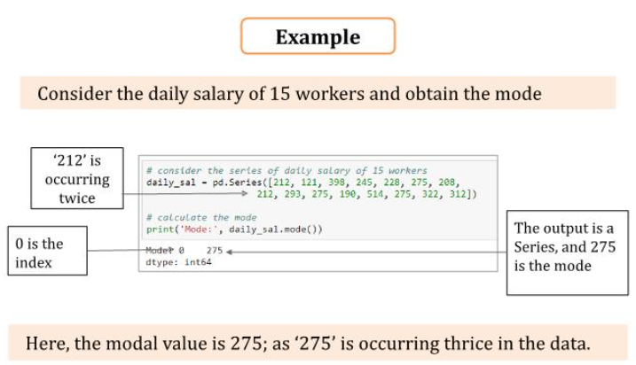

Slide 37
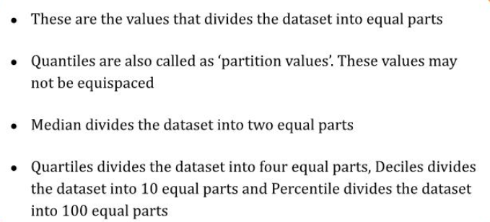
Quantiles

Slide 38
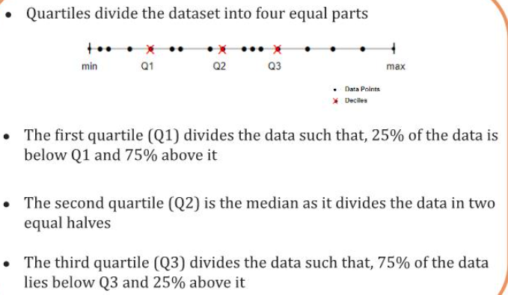

Slide 39
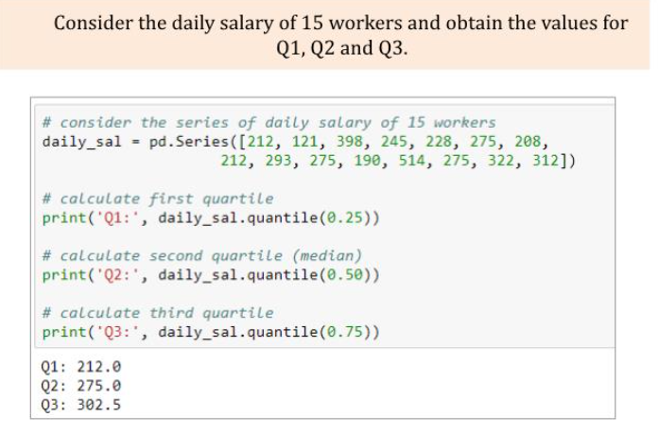

Slide 40
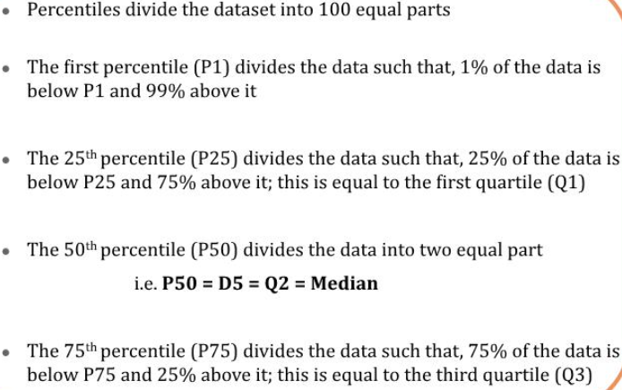
Percentiles

Slide 41
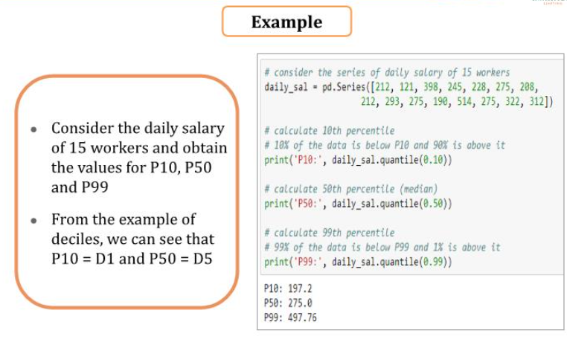

Slide 42
Measures of Dispersion

Slide 43
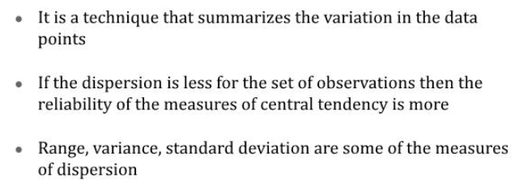

Slide 44
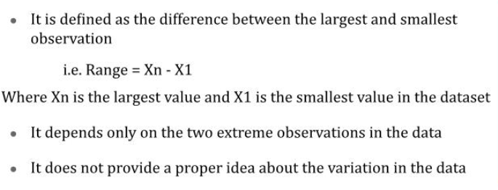
Range

Slide 45
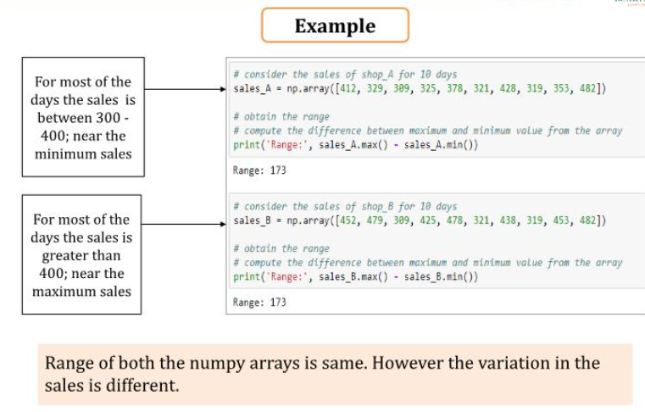

Slide 46
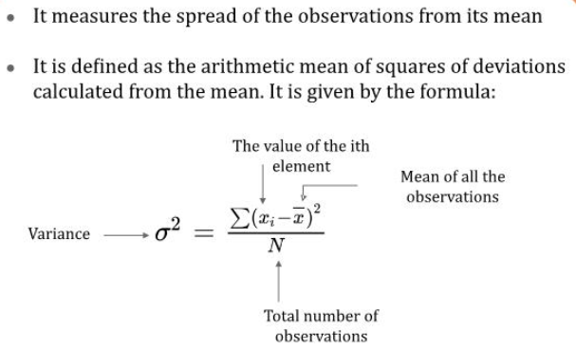
Variance

Slide 47
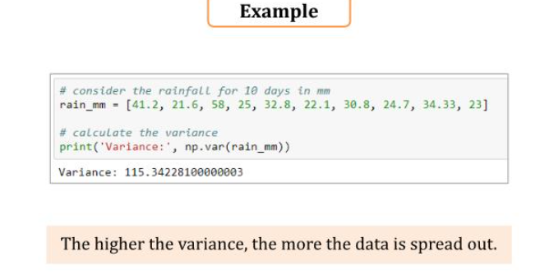

Slide 48
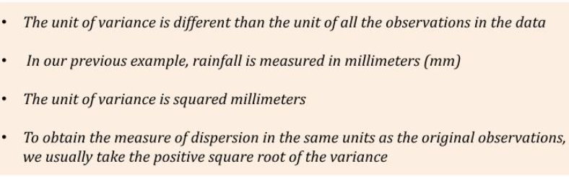

Slide 49
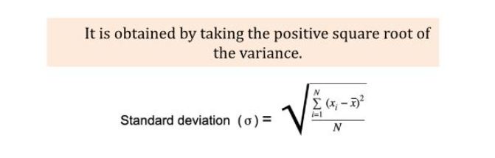
Standard Deviation

Slide 50
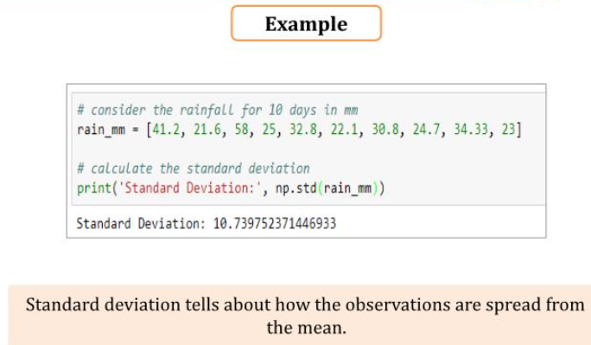

Slide 51
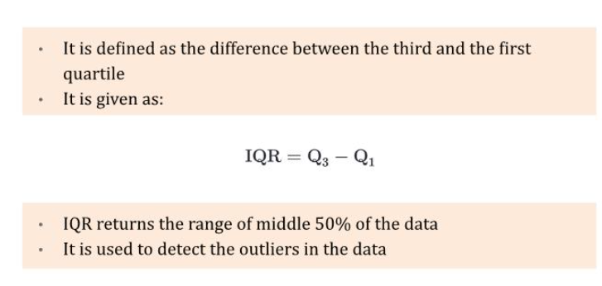
IQR

Slide 52
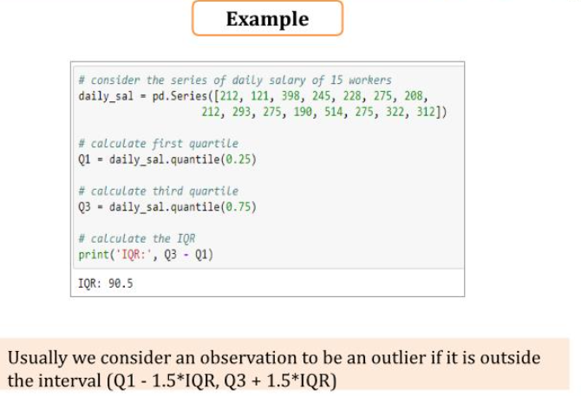

Slide 53
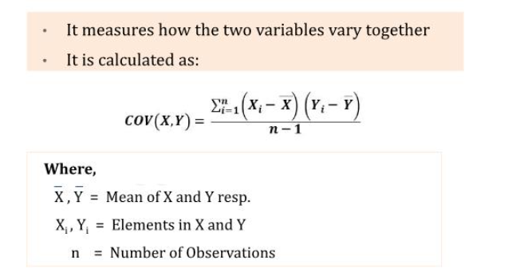

Slide 54
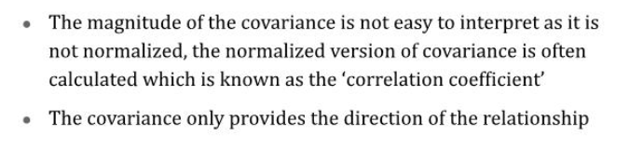

Slide 55
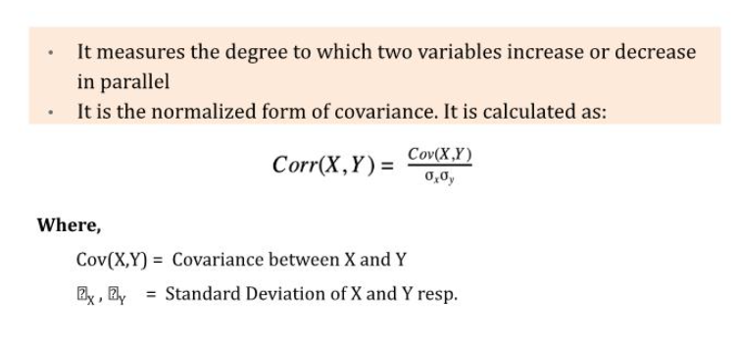

Slide 56
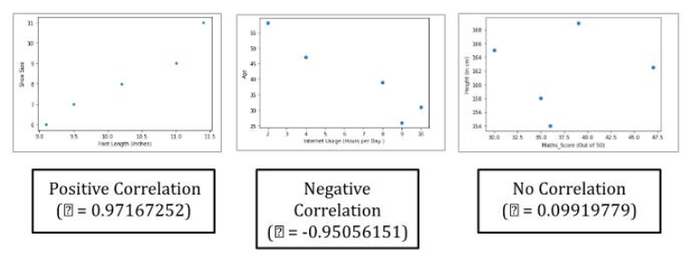

Slide 57
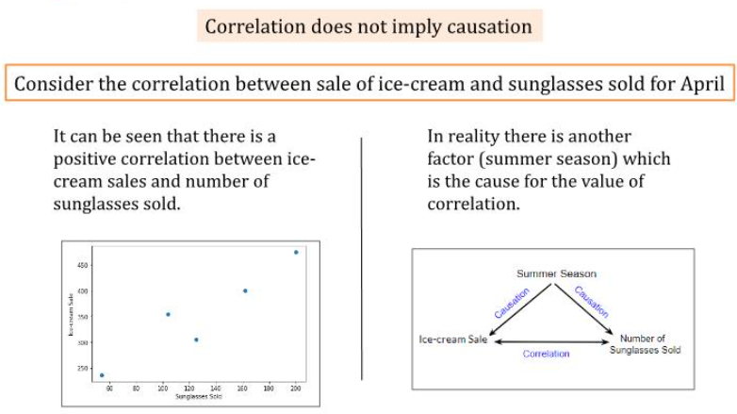

Slide 59
Probability??

